Slide 1
Real-time video call system - with WebRTC
R10525073 工科碩一 徐聖淮
錄影連結：https://drive.google.com/file/d/1hL38HTIQz7NEU4LHwQ-Zb8RioxuU3M_Y/view?usp=sharing

Slide 2
Outline
Introduction
Architecture
Code Review
Live Demo
Conclusion
Reference

Slide 3
1. Introduction
WebRTC is a API that enables Web applications to:
audio and video conferencing
file exchange
screen sharing
Etc...
This project uses WebRTC to make a real-time video call system.
User does not need to install the system and can also execute it on the web page.

Slide 4
2. Architecture
System Type
Web interactive system
System platform
Python, React, Node.js
Mouse and keyboard
User Tab
User Tab
React App
Server

Slide 5
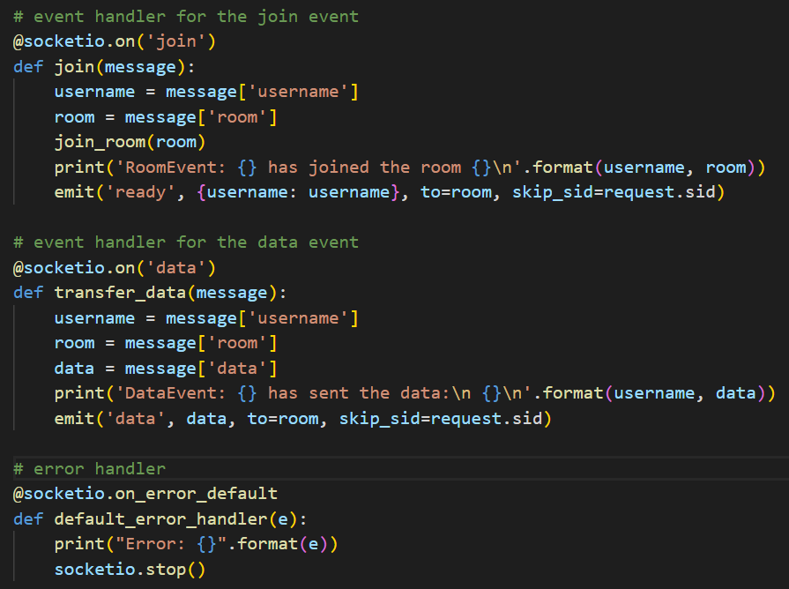
3. Code Review-1
Server.py

Slide 6
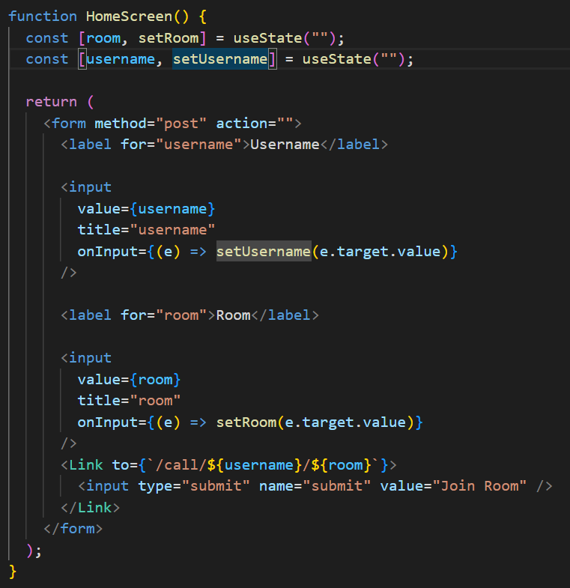
3. Code Review-2
HomeScreen.js

Slide 7
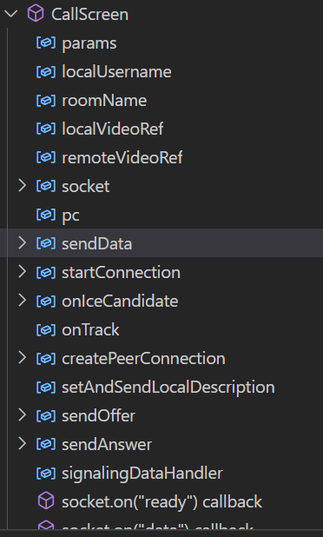
3. Code Review-3
CallScreen.js
Peer A creates a RTCPeerConnection object for the connection.
Peer A creates an offer SDP message with createOffer() and calls setLocalDescription() to set it as the local SDP description.
Peer A now sends this offer in a stringified form to Peer B via a signaling server.
Peer B creates a RTCPeerConnection object and calls setRemoteDescription() with Peer A’s offer to know about its setup.

Slide 8
3. Code Review-4
CallScreen.js
Peer B creates an answer SDP message with createAnswer() and calls setLocalDescription() to set it as the local SDP description.
Peer B now sends this answer in a stringified form to Peer A using a signaling server.
Peer A calls setRemoteDescription() with the answer received in order to know about Peer B’s setup.
Either of these peers can send ICE Candidates to the other on generation, with the help of the onicecandidate callback, and set the candidates received from the other using addIceCandidate().
Connection is established by the end of this flow.

Slide 9
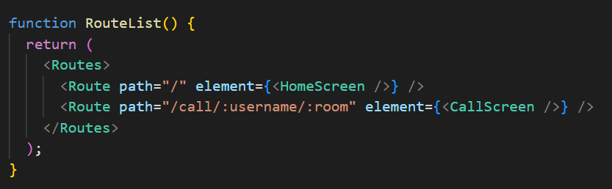
3. Code Review-5
RouteList.js

Slide 10
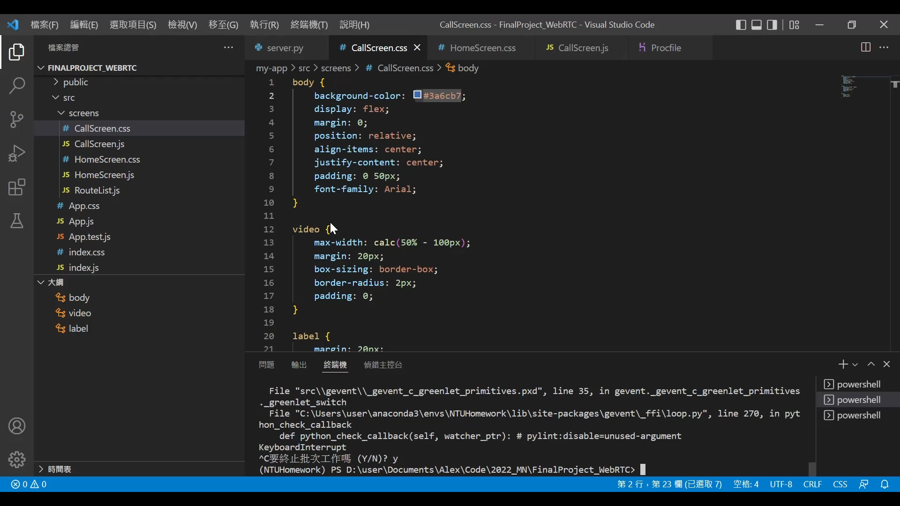
4. Live Demo

Slide 11
5. Conclusion
In this work, we implement a real-time interactive video call system.
We also provide a user-friendly GUI to make the system more practical.
In future work, We hope to integrate more functions, such as text chat, to allow users to have more diverse operation options.

Slide 12
Reference
Build your first WebRTC app with Python and React
Python Flask 入門指南 : 輕量級網頁框架教學
Welcome to Flask — Flask Documentation (2.1.x)
React Documentation
WebRTC API - Web APIs | MDN

Slide 13
The End
Thank you!

